Slide 1
机器学习框架

Slide 2
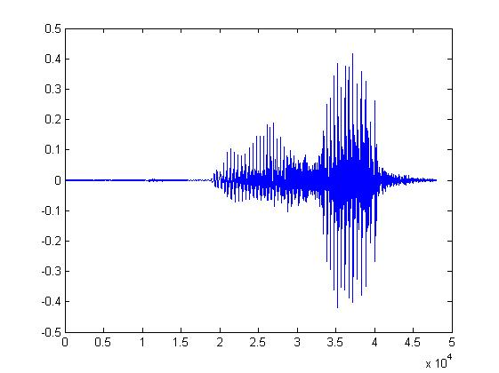
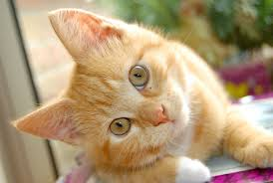
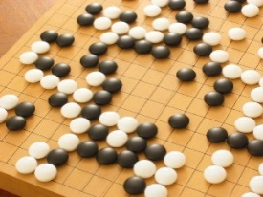
Machine Learning ≈ Looking for a Function
Speech Recognition
Image Recognition
Playing Go
Dialogue System
“How are you”
“Cat”
“5-5”
(next move)
“Hi”
“Hello”
(what the user said)
(system response)

Slide 3
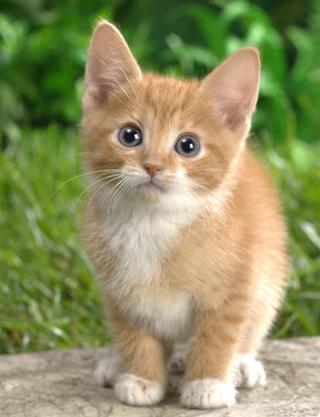

Framework
Image Recognition:
“cat”
A set of function
Model
“cat”
“monkey”
“dog”
“snake”
Notes:
Repeat again

Slide 4
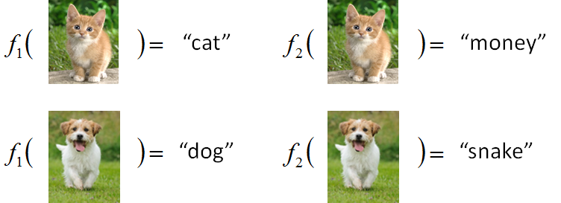

Framework
Image Recognition:
“cat”
A set of function
Model
Better!
Goodness of function f
Supervised Learning
Training
Data
function input:
function output:
“monkey”
“cat”
“dog”
Notes:
Repeat again

Slide 5
Framework
Image Recognition:
“cat”
A set of function
Model
Training
Testing
“cat”
Step 1
Goodness of function f
Pick the “Best” Function
Using
Step 2
Step 3
Training
Data
“monkey”
“cat”
“dog”
Notes:
Repeat again

Slide 6
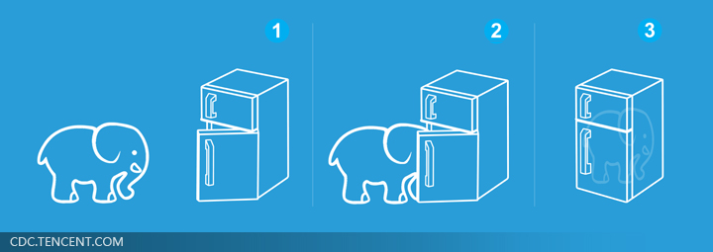
Machine Learning is so simple ……
Step 1: define a set of function
Step 2: goodness of function
Step 3: pick the best function
就好像把大象放進冰箱 ……

